Slide 1
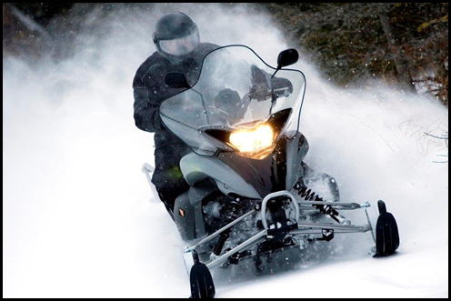
SEASON 2020-2021 GT 600 ACE 2015 ORDUO MODEL 2015 | PRICE
Half-day 3 Hours Monday to Thrusday Half-day 3 Hours Friday to Sunday Day 6 Hours Monday to Thrusday Day 6 Hours Friday to Thrusday | 200 $ 230 $ 255 $ 285 $
PRIVATE GUIDE(1) | 180 $ (3hrs) 300 ^{$ (6hrs)}
Other charges
CARBURANT & ÉQUIPEMENT DIVERS
Late arrivals | 50 $ per half-hour
Towing | 100 $ per hour per employee
3 hours | 30 $
Day | 50 $
Cowl | 10 $
Mitt and Foot warmer | 4 $
Schedule | Please arrive 45 minutes early
Half-day | 9:00 Am to 12:00/ 1:00 Pm to 4:00 Pm
Day | 9:00 Am to 4:00 Pm
Maximum 6 snowmobiles, guide’s beverages and meals included in the case of a full day
2237 Chemin du Lac Nantel Sud, St-Faustin-Lac-Carré. 819-326-5454 www.royallaurentien.com
All of these rates do not include taxes and are subject to change without further notice, certain conditions may apply

Slide 2
OUR PRICES INCLUDE
Liability insurance up to 1,000,000$ **
Helmets
Clothes for 2 people ( helmet, warm boots, suits and mitts )
Trail access permit
EXTRAS
The taxes (TPS et TVQ)
Gas and oil return
Guides Tips if applicable (at your discretion)
Madatory security deposit of $ 2,500 per snowmobile (cash – Visa – Master Card). This deposit is to be paid prior to access to the material by the client and is fully or partially reemboursed (imputed of eventual charges due to damage done) after inspection at the moment of remittance of the material. Refusal or the impossibility on the behalf of the client to pay the security deposit automatically entails the cancellation of the excursion.
TERMS AND CONDITIONS
A booking deposit representing 30% of the total amount is payable at the time of rental;
For any change or cancellation made within 72 hours of the date / time of the activity, 100% of the reservation is non-refundable. For those who do not show up, we will deduct the total amount for the activity. ( Not applicable if the trails do not allow the activity);
The driver must be at least 21 years old with a valid driver’s licence. Children (5 years old minimum) must be able to sit and hold themselves behind the adult. Mothers-to be are not allowed on snowmobiles for the wellbeing of the baby.
If the snowmobile is accidented, damaged or stolen, the customer is liable for the first $ 2,500 in damages and the cost of transportation and towing;
A snowmobile lease must be completed before any departure for the main driver and additional drivers;
The definitive routes are chosen by the local guide according to the weather conditions;
Rates shown are subject to change without notice and do not include taxes, certain conditions apply;
** INSURANCE: Driver or passenger injuries are NOT covered by this insurance.

